Slide 1
Message exchange and Data Type
Service-Oriented Software Engineering
Software Institute
Nanjing University
Bei Jia

Slide 2
Electronic Information Exchange (1/2)
Electronic information exchange is a simple concept:
  Electronically encoded information of one sort or another moves among software units during the execution of some domain-(business) related function.
There are several contexts for information exchange:
  Intra-application - information movement among the parts of an application.
  Inter-application - information movement between applications in the same company system.
  Inter-company - information movement between companies.
  Inter-system - information movement between systems in the same company.

Slide 3
Electronic Information Exchange (2/2)

Slide 4
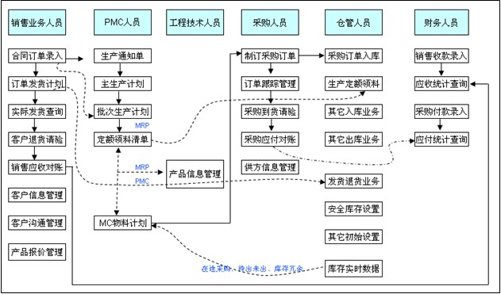
Review: 计算与软件工程

Slide 5
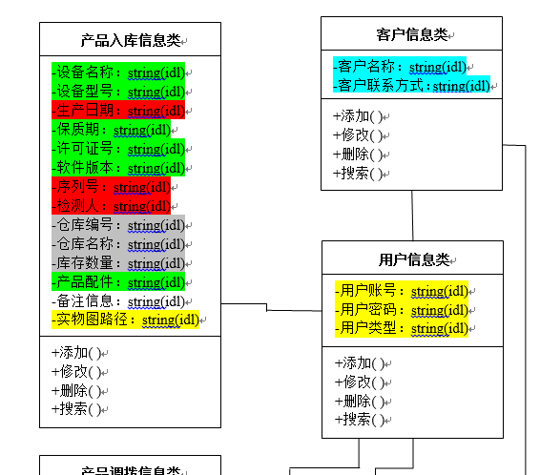
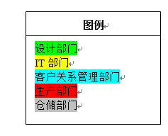
Review: 类图（局部）

Slide 6
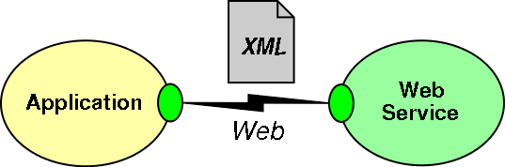
XML & etc. in Services Computing
XML & etc. act as the meta-language in Services Computing, they are used to
  Describe service
    Sequence and interface
  Describe service requirement to find and call services
  Other message exchange performed in Services Computing
They are used to perform the electronic information exchange

Slide 7
Data Types in Services Computing
Services are published/ discovered/ invoked with XML messages
Another problem in XML message exchange is the data types
One method is to validate a XML message against XML schema script
A set of XML schema scripts can be accepted in particular industry and published over internet, they can be regarded as “Data Type Standard”

Slide 8
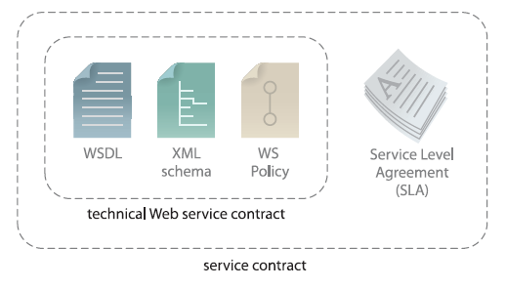
Recall: 服务合约
建立了与服务交互有关的术语
提供了技术限制和需求，及服务的拥有者希望对外公布的所有语义信息

Slide 9
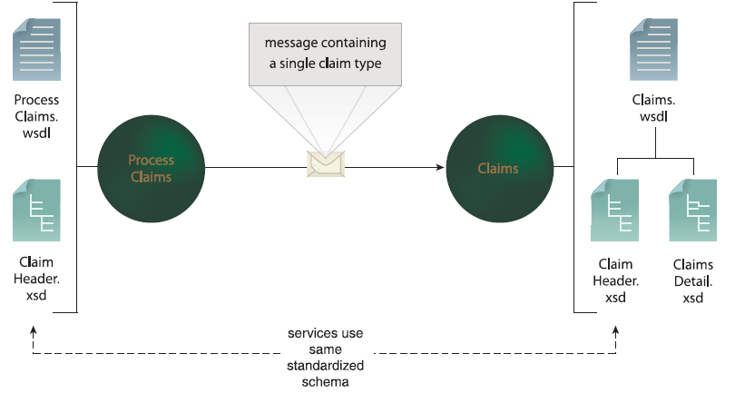
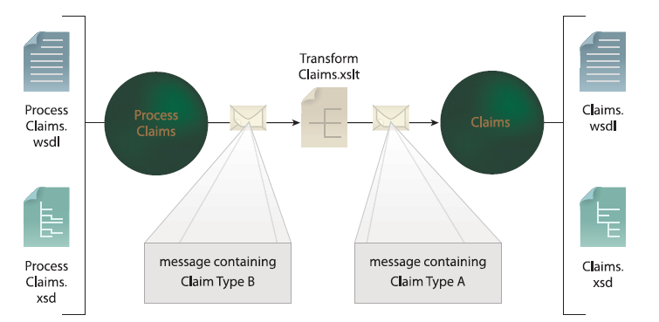
数据表示标准化和转换的避免

Slide 10
Schema 集中化
由NameSpace持有者统一定义Schema
  全球范围内的统一版本
    统一定义
    统一使用
    统一演化
  维持通用性
    多个应用的数据结构保持一致
    单个应用在长时间演化过程中数据结构不变
      实现/代码/技术/平台/支持系统变更，但是包含数据结构在内的服务合约长时间不变（长时间复用的基本前提）

Slide 11
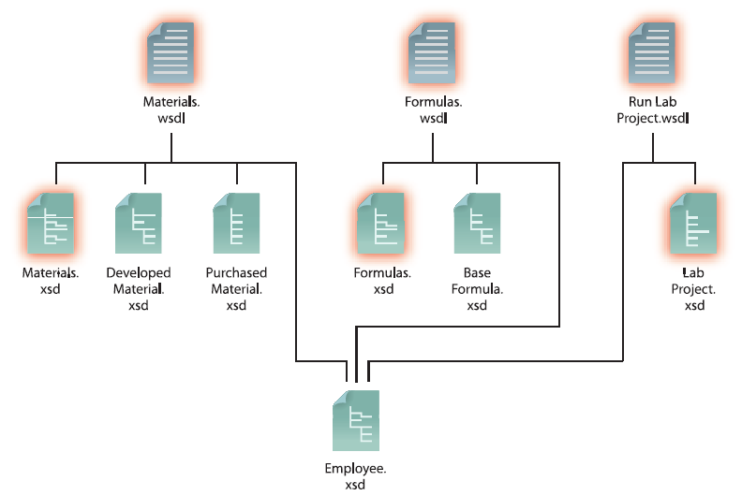
标准化的服务和数据表示层

Slide 12
冗余？
Student.xsd由教务持有，仅包含实现教务系统的最小信息集合吗？
  校医院？院系？ ……
  民政局？公安局？……
  这些数据，教务有权定义吗？
在我们设计涉及到学生的服务合约时，使用什么样的数据结构？
从OO的角度，削减冗余的前提下，提供且仅提供功能所需的信息
从SO的角度，应该使用官方Schema
  如果当前的服务仅仅只是上课签到，涉及到学生的数据结构还包含个人的犯罪记录？
  这种冗余是不是有些蠢？

